Slide 1

Use of solar power systems
Dr . Raghad Al-journi

Slide 2


1
There are many types of renewable energy sources, the six most common are:
Sun (solar) energy, including solar thermal energy and photovoltaic
(PV)
Biofuel
Wind power
Hydro power
Geothermal power
Wave power from the oceans and seas.

Slide 3
2

Slide 4
3
100% Renewable Energy Energy Mix

Slide 5
4

Slide 6
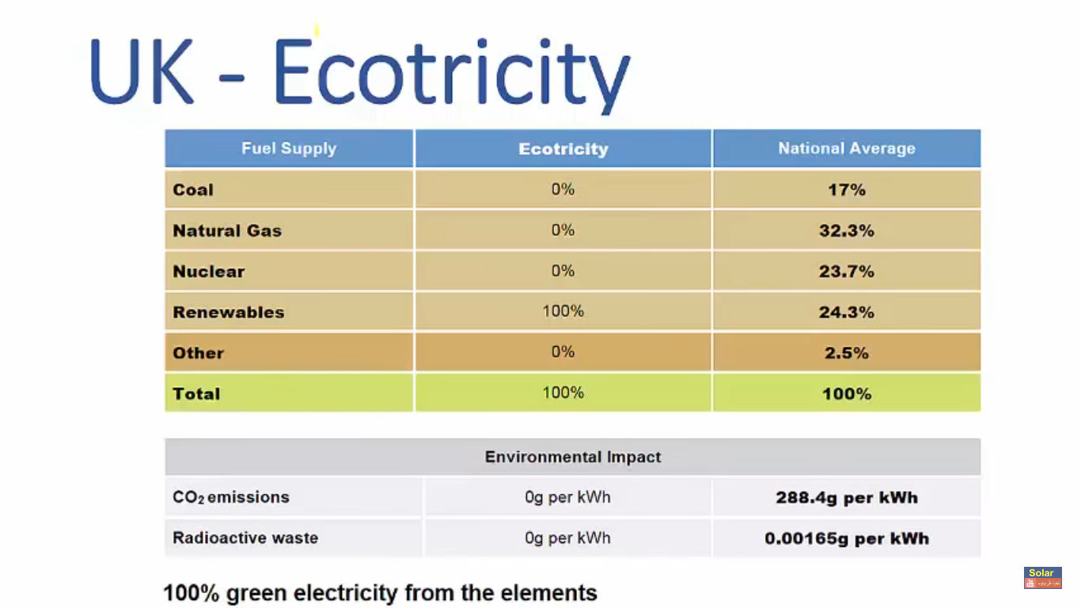
5

Slide 7
6
Highly influenced by weather conditions

Slide 8
7
Solar Thermal Technologies Suitable For Iraq
1- Parabolic Trough Designs
2- Solar Thermal Power Tower
3- Photovoltaic (PV) Technology
4- Dish Stirling System

Slide 9
8
Daily average solar radiation for different regions Iraq, kW · h / m2

Slide 10
9
Variation of solar radiation intensity in three Iraqi governorates, Baghdad, Mosul and Basrah, for one year period.

Slide 11
Features of PV
10

Slide 12
11
Types of solar cell

Slide 13
12

Slide 14
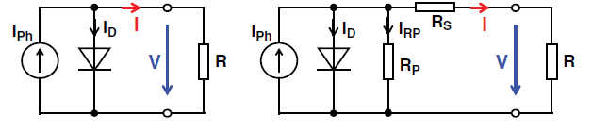
13
Equivalent Circuit of a Solar Cell
Simplified diagram of an equivalent circuit for a loaded solar cell (no-load , R= ; shorted, R=0). IPh is
proportional to irradiance G and solar cell area
IPh =photocurrent ( G)=solar cell short-circuit current ISC
IS =saturation current in the reverse direction

Slide 15
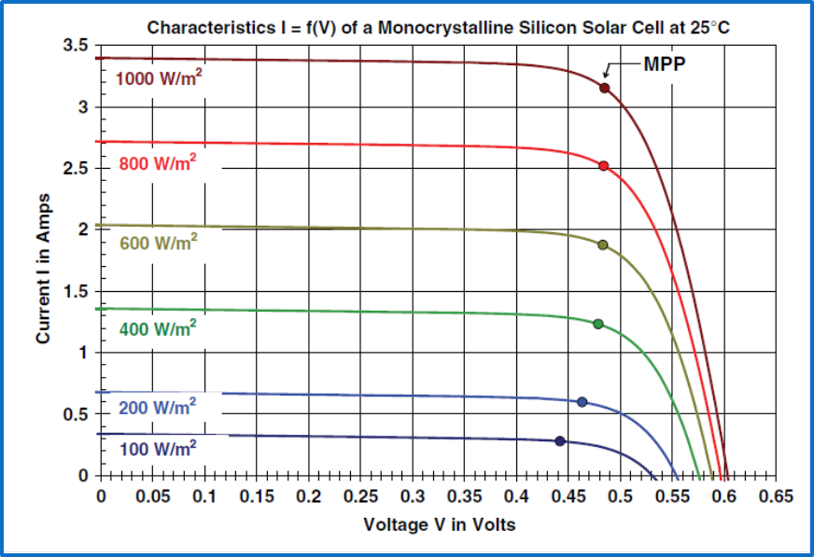
14
Characteristic curves I=f(V) and P=f(V) of a monocrystalline silicon solar cell with a cell area of approximately 102 cm2, irradiance G amounting to
1 kW/m2 and 25 C cell temperature
Characteristic curves I=f(V) for the solar cell cell temperature of 25 C and irradiance G as a parameter AM1.5

Slide 16
15
Efficiency of the monocrystalline Si solar cell at a cell temperature of 25 C, as a function of irradiance G AM1.5
Characteristic curves I=f(V) for the solar cell, with irradiance G=1 kW/m2 AM1.5 and with cell temperature as parameter

Slide 17
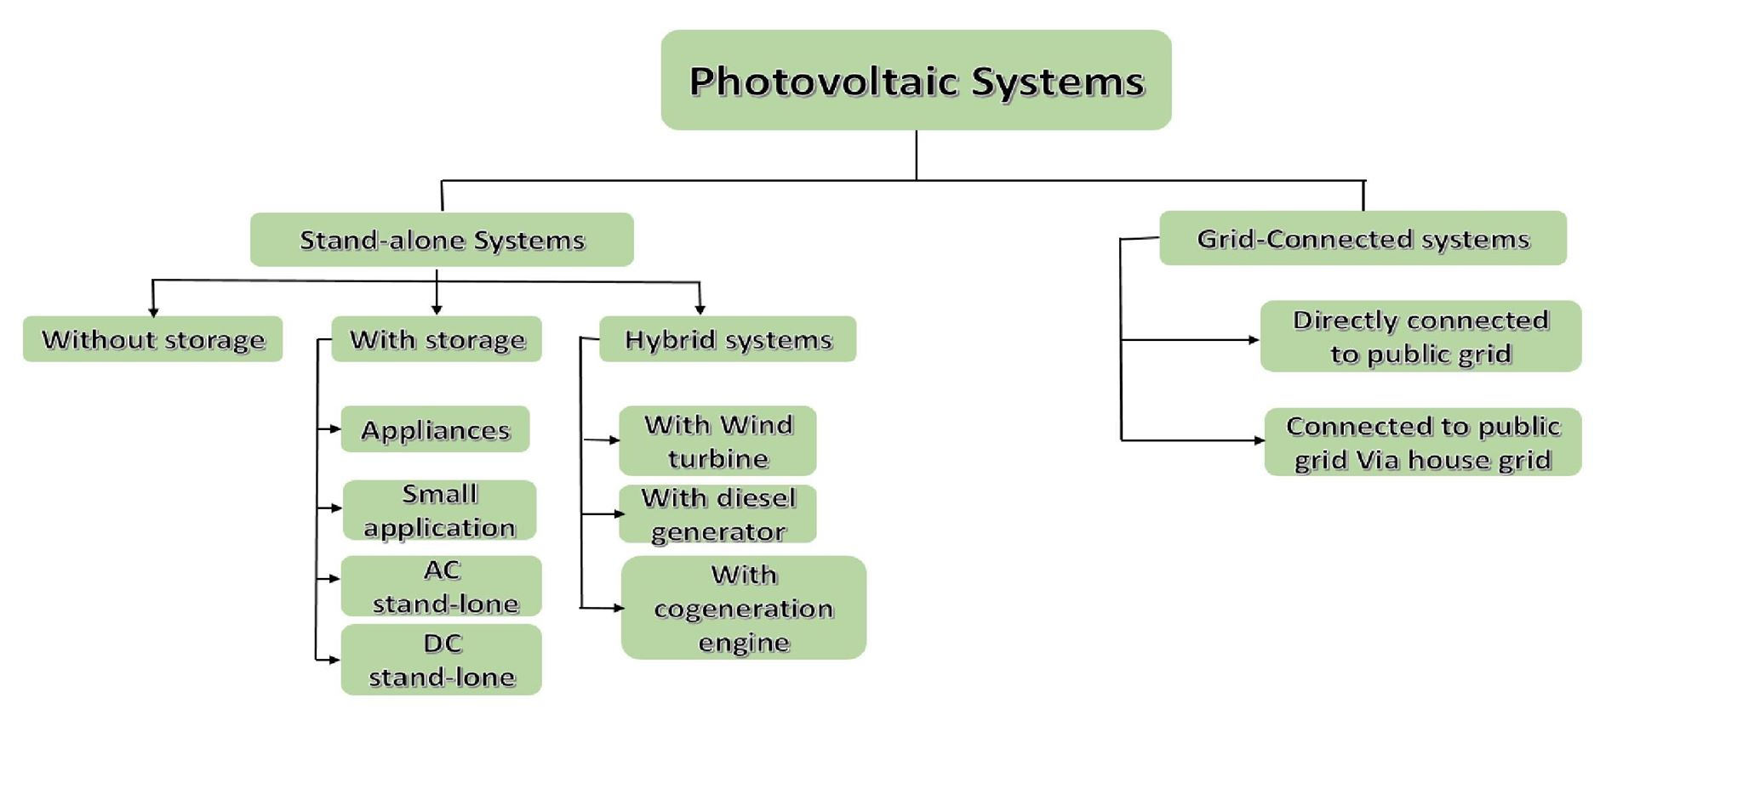
16

Slide 18
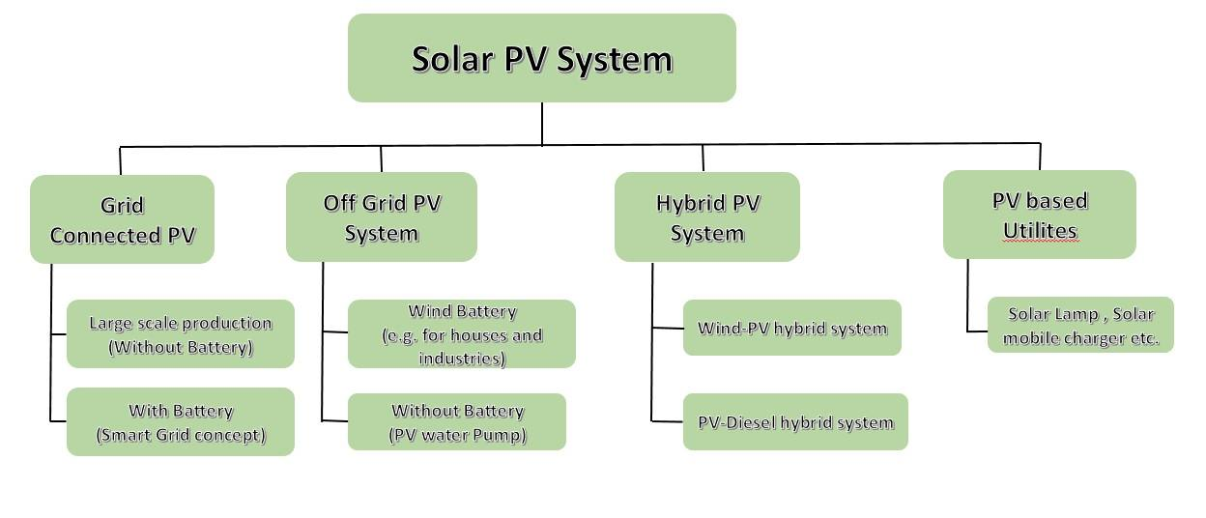
17

Slide 19
18

Slide 20
19

Slide 21
20

Slide 22
21

Slide 23
22

Slide 24

PV Direct System
23
Solar Water Pumping in Agriculture
pv
tank
pump

Slide 25
24

Slide 26
25
Small DC

Slide 27
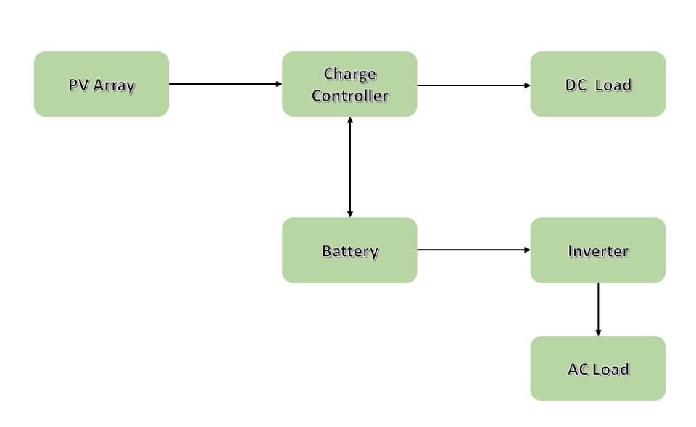
27
Off Grid Connected PV Systems with Battery Storage

Slide 28
Off Grid Connected PV System for Street Lighting
28

Slide 29
29
Off Grid Connected PV System for Communication station

Slide 30
30

Slide 31
Large DC
31

Slide 32
32
Large AC/DC

Slide 33
Off Grid Connected PV System for Building
33

Slide 34
34
Off- Grid Centralized Solar System for Electric Power Distribution

Slide 35
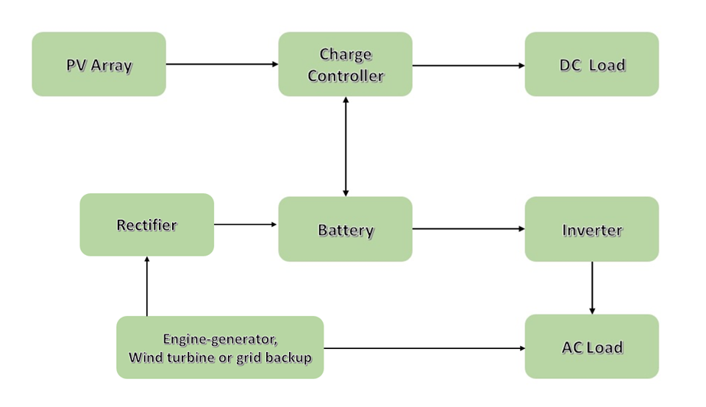
Diagram of Photovoltaic of Hybrid System
35

Slide 36
Hybrid System
36

Slide 37
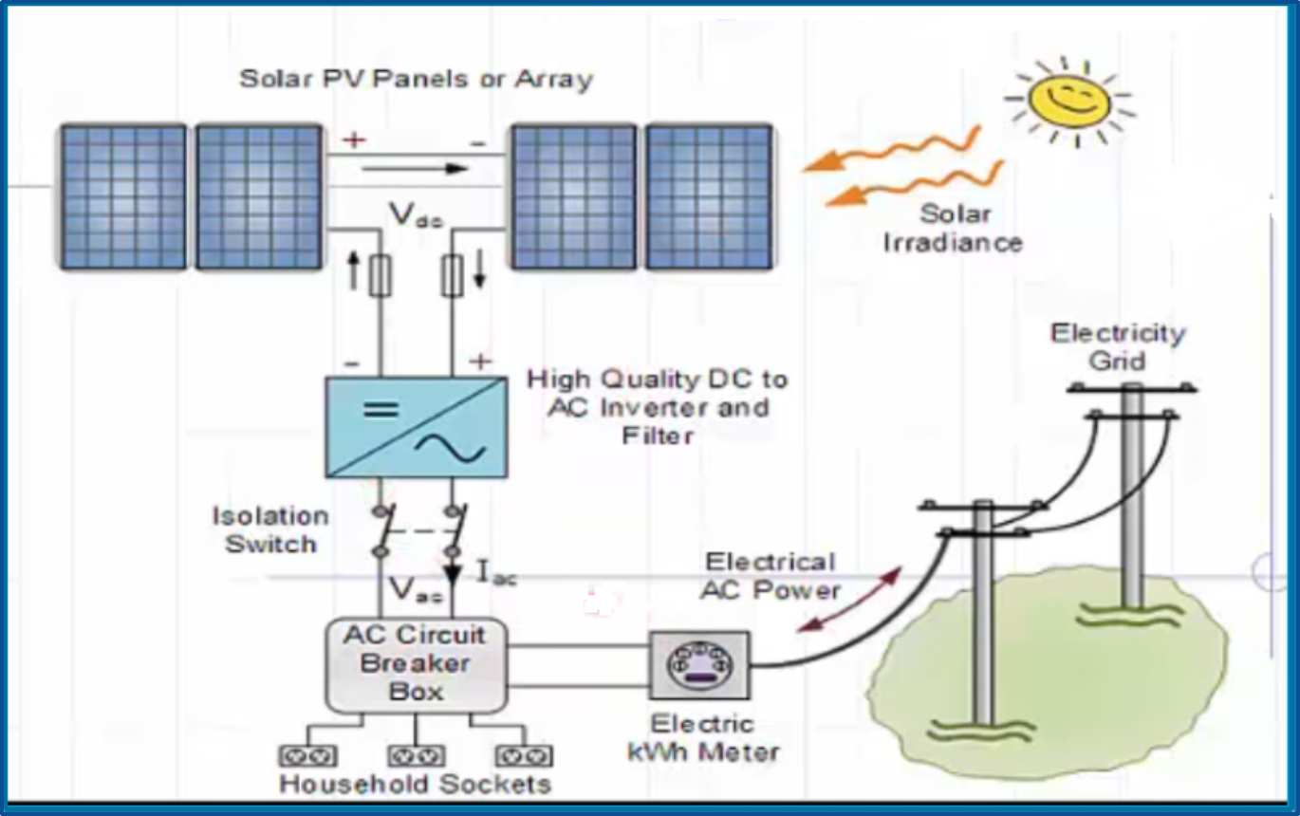
On – grid solar PV system
37

Slide 38
38
Aerial view of the 5MWp Land PV installation
Partial view of an array
on the roof

Slide 39
39
Aerial view of two of the three 50MW solar thermal power plants in southern Spain
View of half of the installation’s 1.13kWp
solar generator, which is mounted on
theResearch Station (HFSJG, 3454 m, 46.5N). Two insolation sensors (areference cell and a heated
pyranometer) are visible on the right

Slide 40
THANK YOU

